Slide 1
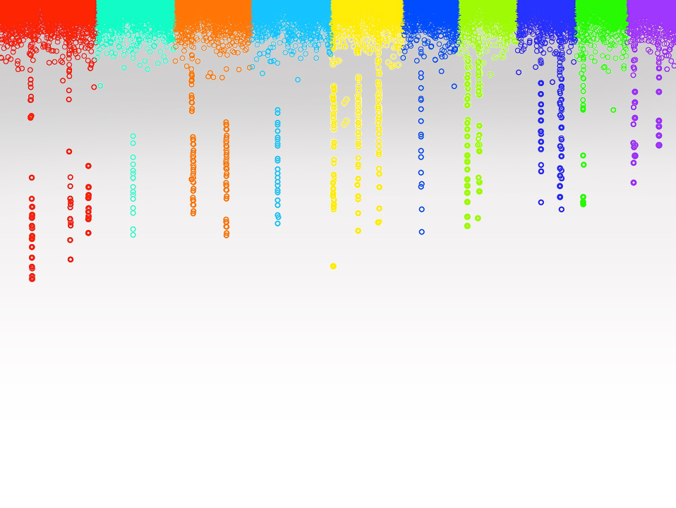

Statistical Genomics
Lecture 28: Bayesian Tools
Zhiwu Zhang
Washington State University

Slide 2
Administration
Homework 6 (last) due April 27, Friday, 3:10PM
Final exam: May 2/4, 120 minutes (3:10-5:10PM), 50 questions
Course evaluation
Group picture after class

Slide 3
Outline
BAGS
BLR/BGLR

Slide 4
BAGS
Bayesian Alphabet for Genomic Selection (BAGS)
source("http://www. zzlab.net/sandbox/BAGS.R
Based on the source code originally developed by Rohan Fernando (http://taurus.ansci.iastate.edu/wiki/projects)
Intensively revised
Methods: Bayes A, B and Cpi

Slide 5
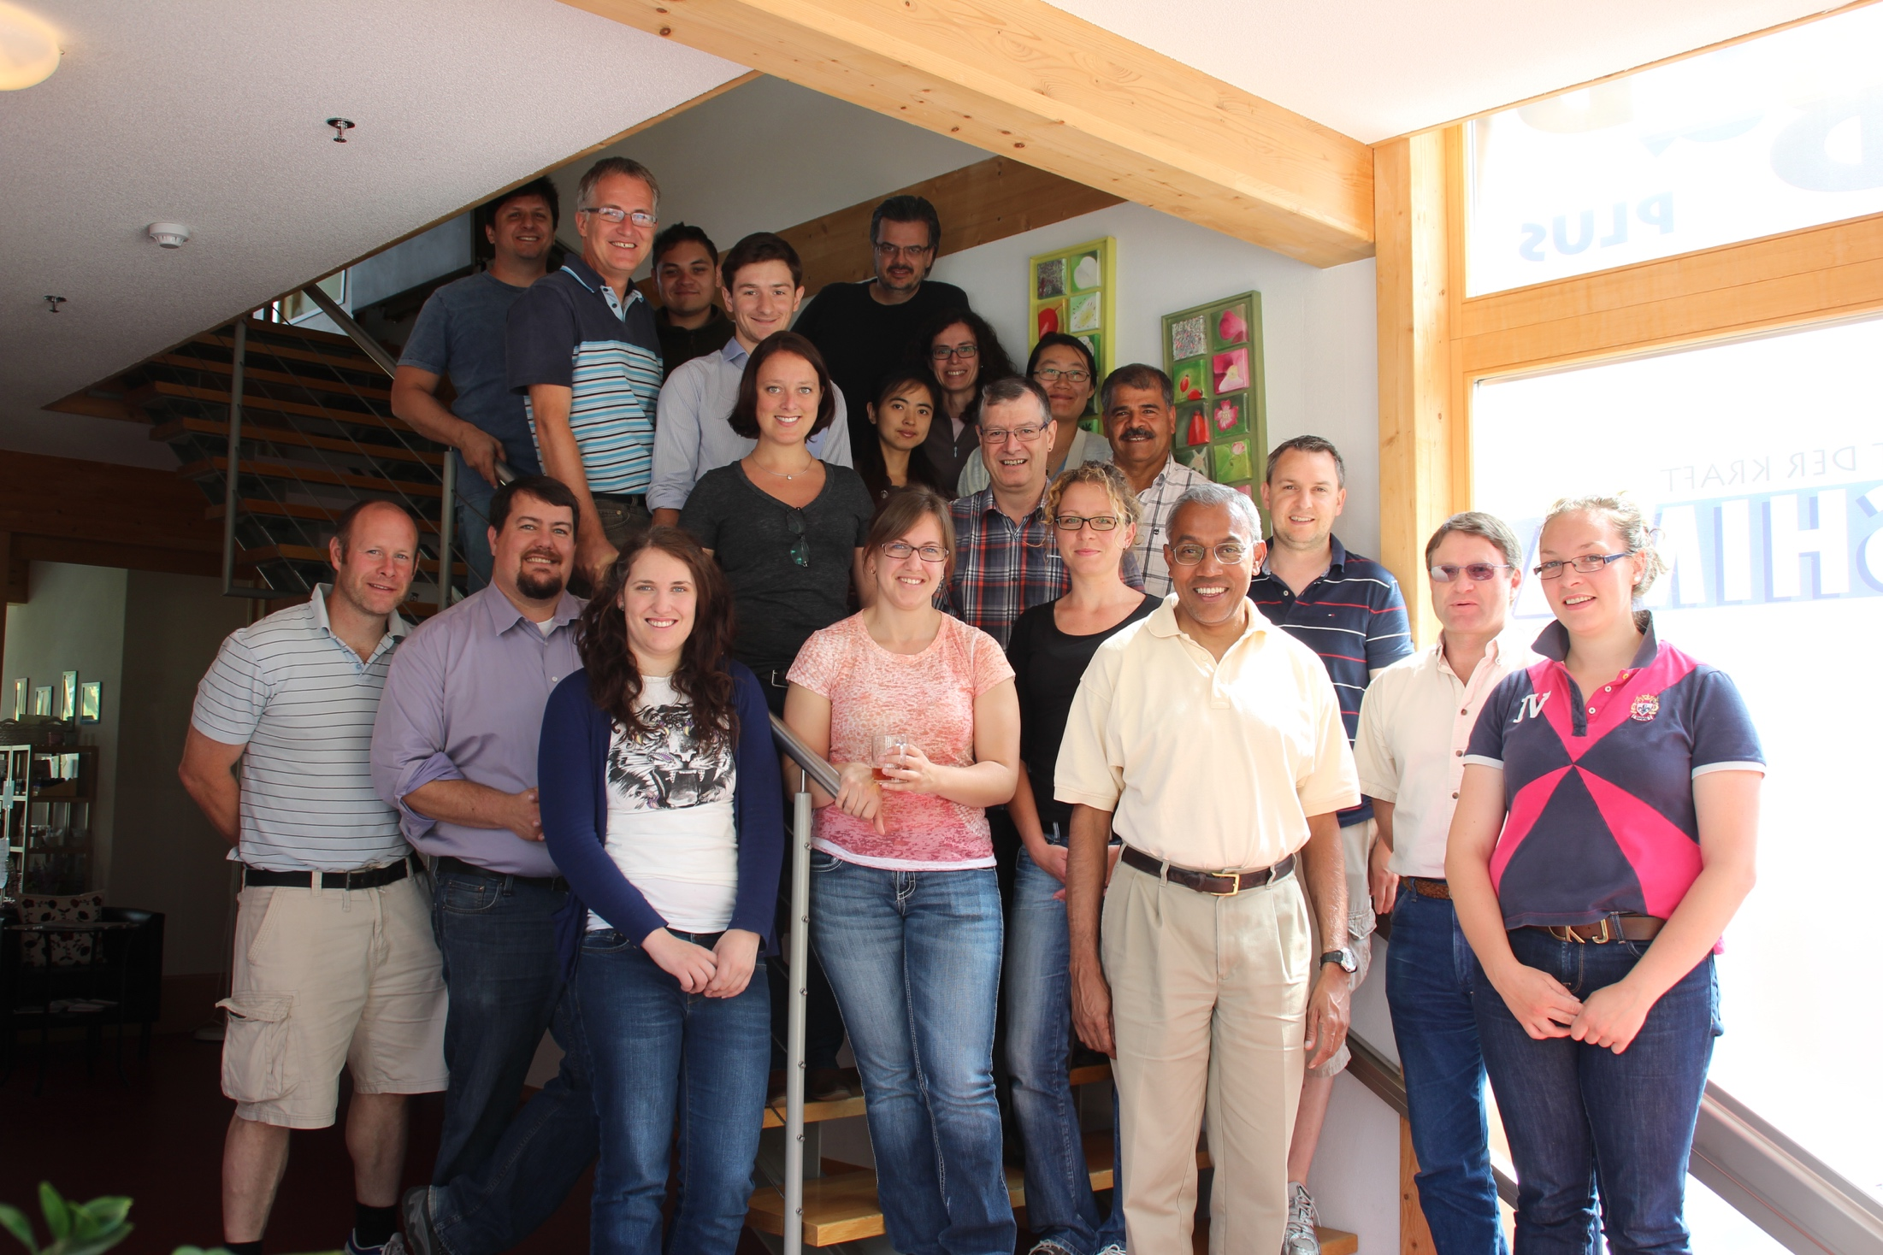
http://taurus.ansci.iastate.edu/wiki/projects
Rohan Fernando
Dorian J Garrick
Jack C M Dekkers

Slide 6
Input
G: numeric genotype with individual as row and marker as column (n by m).
y: phenotype of single column (n by 1)
pi: 0 for Bayes A, 1 for Cpi and between 0 and 1 for Bayes B
burn.in: number iterations not used
burn.out: number iterations used
recording: T or F to return MCMC results

Slide 7
Output
$effect: The posterior means of marker effects (m elements)
$ var: The posterior means of marker variances (m elements)
$ mean: The posterior mean of overall mean
$ pi: The posterior mean of pi
$ Va: The posterior mean of variance of SNP effects (CPi)
$ Ve: The posterior mean of variance of residual effects

Slide 8
Output of MCMC with t iterations
$mcmc.p: The posterior samples of four parameters (t by 4 elements)
$ mean: The posterior mean of overall mean
$ pi: The posterior mean of pi
$ Va: The posterior mean of variance of SNP effects (Cpi)
$ Ve: The posterior mean of variance of residual effects
$mcmc.b: The posterior samples of marker effects (t by m elements)
$mcmc.v: The posterior samples of marker variances (t by m elements)

Slide 9
Set up GAPIT and BAGS
rm(list=ls())
#Import GAPIT
#source("http://www.bioconductor.org/biocLite.R")
#biocLite("multtest")
#install.packages("EMMREML")
#install.packages("gplots")
#install.packages("scatterplot3d")
library('MASS') # required for ginv
library(multtest)
library(gplots)
library(compiler) #required for cmpfun
library("scatterplot3d")
library("EMMREML")
source("http://www.zzlab.net/GAPIT/emma.txt")
source("http://www.zzlab.net/GAPIT/gapit_functions.txt")
#Prepare BAGS
source('http://zzlab.net/sandbox/BAGS.R')

Slide 10
Data and simulation
#Import demo data
myGD=read.table(file="http://zzlab.net/GAPIT/data/mdp_numeric.txt",head=T)
myGM=read.table(file="http://zzlab.net/GAPIT/data/mdp_SNP_information.txt",head=T)
myCV=read.table(file="http://zzlab.net/GAPIT/data/mdp_env.txt",head=T)
X=myGD[,-1]
taxa=myGD[,1]
index1to5=myGM[,2]<6
X1to5 = X[,index1to5]
GD.candidate=cbind(as.data.frame(taxa),X1to5)
set.seed(99164)
mySim=GAPIT.Phenotype.Simulation(GD=GD.candidate,GM=myGM[index1to5,],h2=.5,NQTN=20, effectunit =.95,QTNDist="normal",CV=myCV,cveff=c(.2,.2),a2=.5,adim=3,category=1,r=.4)
set.seed(99164)
n=nrow(mySim$Y)
pred=sample(n,round(n/5),replace=F)
train=-pred

Slide 11
Run GAPIT
myY=mySim$Y
y <- mySim$Y[,2]
myGAPIT <- GAPIT(
Y=myY[train,],
GD=myGD,
GM=myGM,
PCA.total=3,
CV=myCV,
group.from=1000,
group.to=1000,
group.by=10,
QTN.position=mySim$QTN.position,
memo="MLM")
order.raw=match(taxa,myGAPIT$Pred[,1])
pcEnv=cbind(myGAPIT$PCA[,-1],myCV[,-1])
acc.GAPIT=cor(myGAPIT$Pred[order.raw,5][pred],mySim$u[pred])
fit.GAPIT=cor(myGAPIT$Pred[order.raw,5][train],mySim$u[train])
acc.GAPIT
fit.GAPIT
0.3032198
0.7337175

Slide 12
GWAS

Slide 13
RUN BAGS with different model
niter=200
m=ncol(X)
GR=myGD[train,-1];YR=as.matrix(mySim$Y[train,2])
GI=myGD[pred,-1];YI=as.matrix(mySim$Y[pred,2])
#Bayes A:
myBayes=BAGS(X=GR,y=YR,pi=0,burn.in=100,burn.out=100,recording=T)
#Bayes B:
myBayes=BAGS(X=GR,y=YR,pi=.95,burn.in=100,burn.out=100,recording=T)
#Bayes Cpi:
myBayes=BAGS(X=GR,y=YR,pi=1,burn.in=100,burn.out=100,recording=T)
par(mfrow=c(2,2), mar = c(3,4,1,1))
plot(myBayes$mcmc.p[,1],type="b")
plot(myBayes$mcmc.p[,2],type="b")
plot(myBayes$mcmc.p[,3],type="b")
plot(myBayes$mcmc.p[,4],type="b")

Slide 14
Bayes Cpi
A, B, or Cpi?
Overall mean
Pi
Va
Ve

Slide 15
Bayes B
A, B, or Cpi?
Overall mean
Pi
Va
Ve

Slide 16
Bayes A
A, B, or Cpi?
Overall mean
Pi
Va
Ve

Slide 17
Visualizing MCMC
myVar=myBayes$mcmc.v
av=myVar
for (j in 1:m){
for(i in 1:niter){
av[i,j]=mean(myVar[1:i,j])
}}
ylim=c(min(av),max(av))
plot(av[,1],type="l",ylim=ylim)
for(i in 2:m){
points(av[,i],type="l",col=i)
}

Slide 18
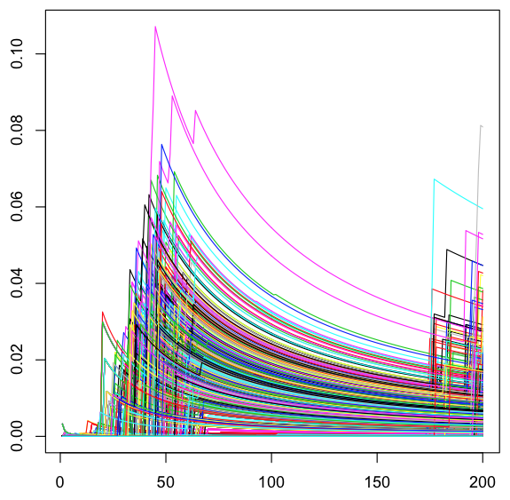
Changes of cumulative averages
Variance
Iteration

Slide 19
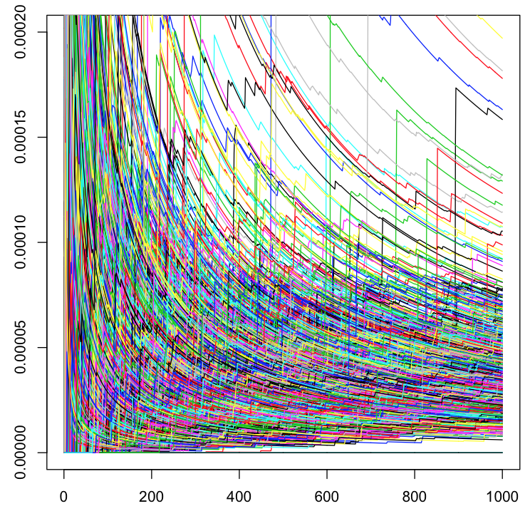
1,000 iterations
New stars
Variance
Iteration

Slide 20
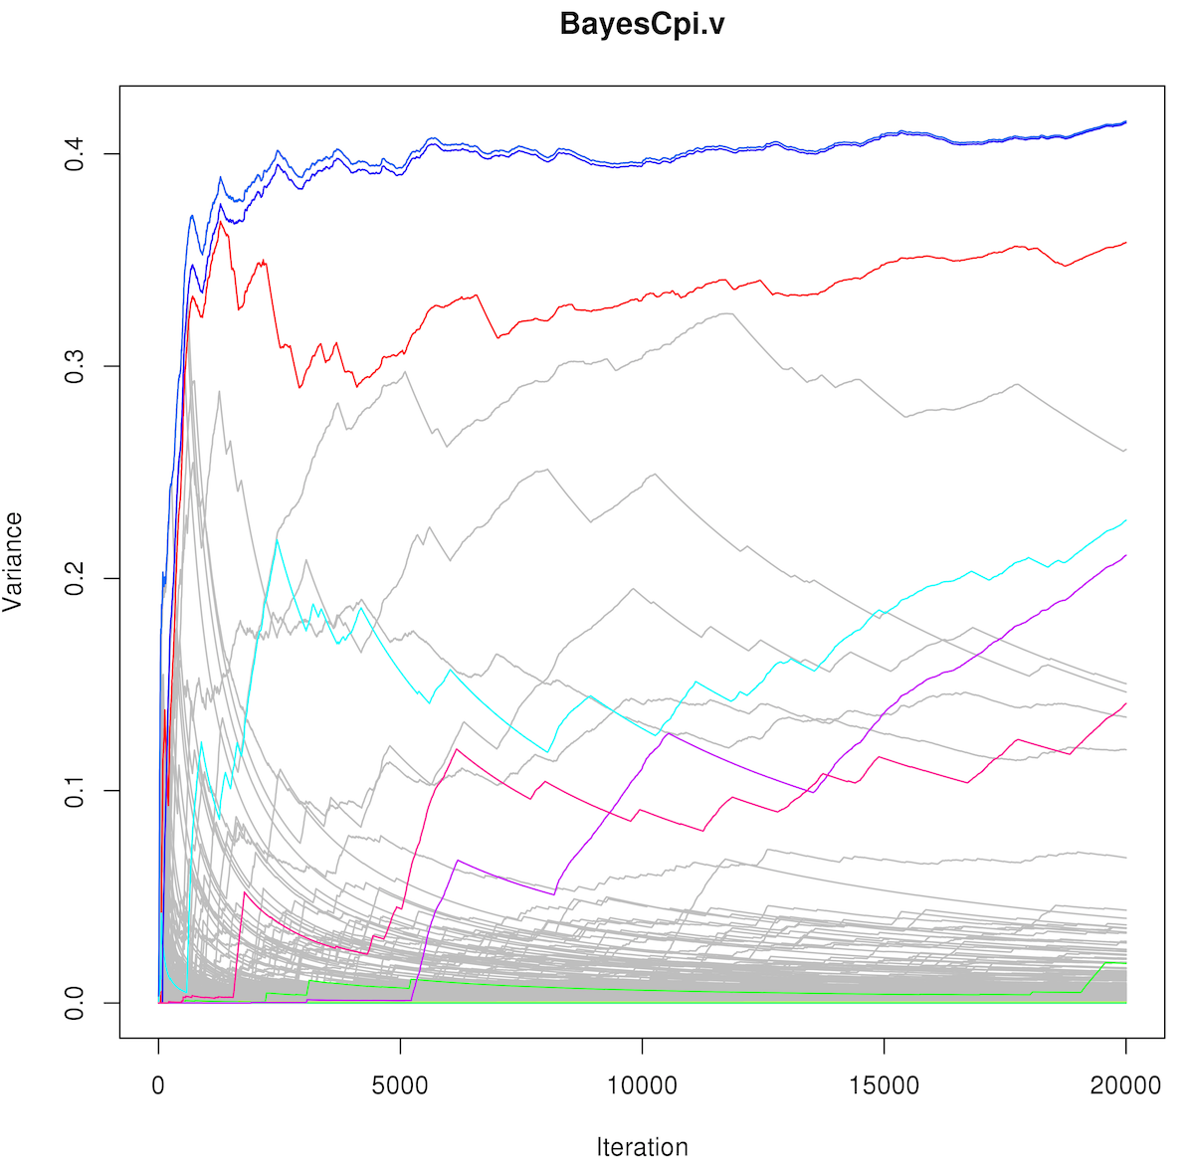
20,000 iterations are still not enough!
QTNs in colors
going up
non-QTNs in gray
going down

Slide 21
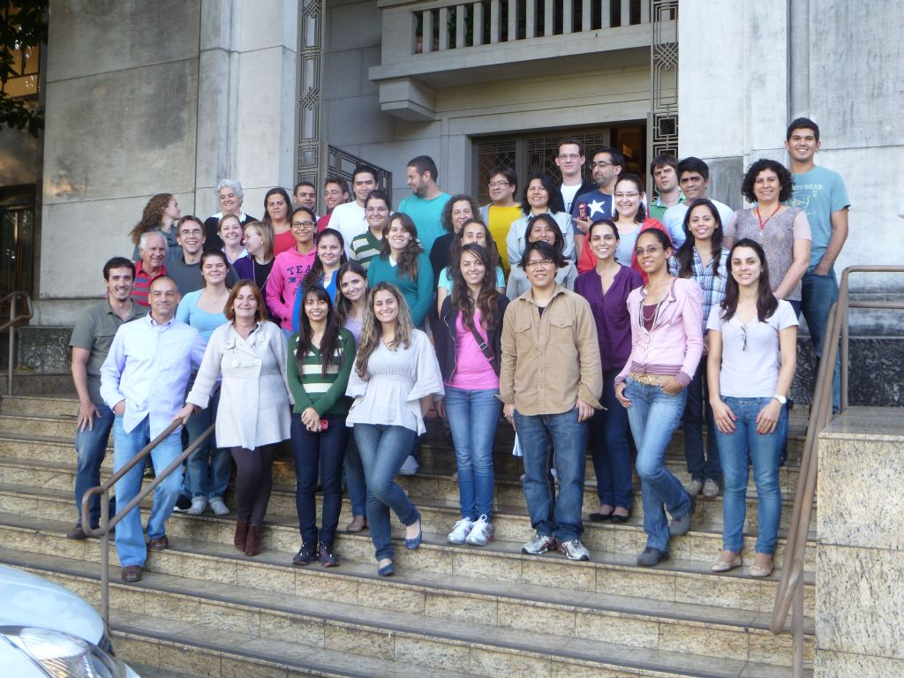
BLR and BGLR
Daniel Gianola
Gustavo
de los Campos
Jose Crossa
Guilherme Rosa
http://www.lce.esalq.usp.br/arquivos/aulas/2013/LCE5713/

Slide 22
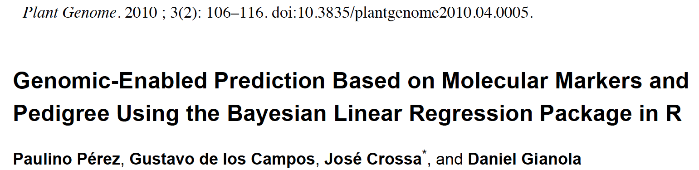
Papers of BLR and BGLR
Genome-Wide Regression & Prediction with the BGLR Statistical Package
Paulino Pérez and Gustavo de los Campos
GENETICS Early online July 9, 2014; https://doi.org/10.1534/genetics.114.164442

Slide 23
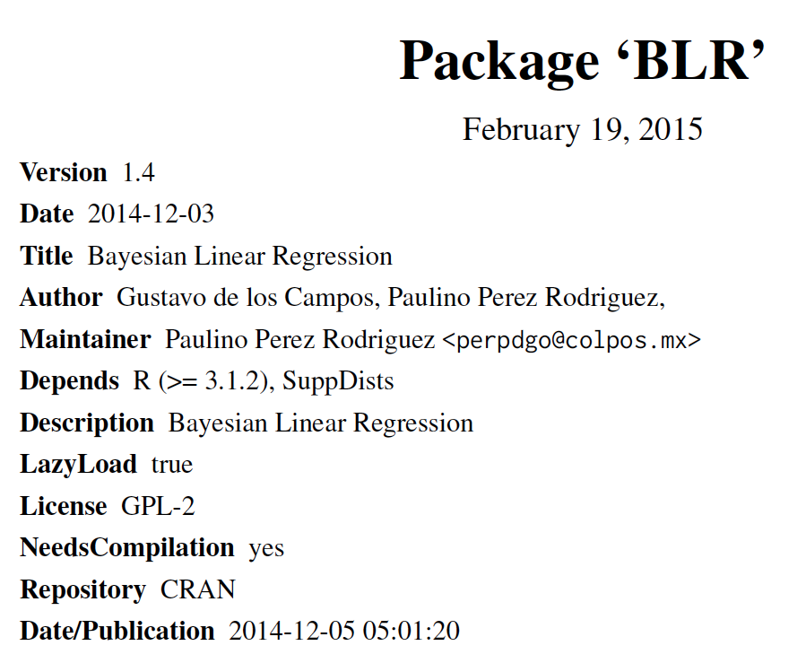
#install.packages("BLR")
library(BLR)

Slide 24
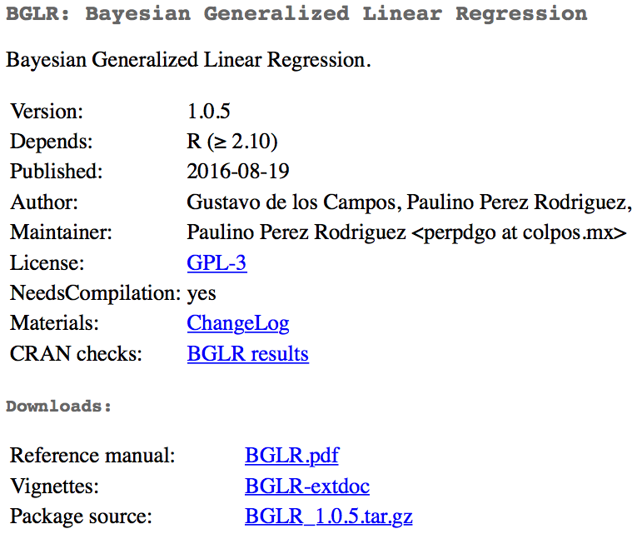
#install.packages("BGLR")
library(BGLR)

Slide 25
Model in BLR
Breeding values
(gBLUP)
Intercept
Fixed effects
(MAS)
Bayeian LASSO
(Bayes)
random regression
(Ridge regression)

Slide 26
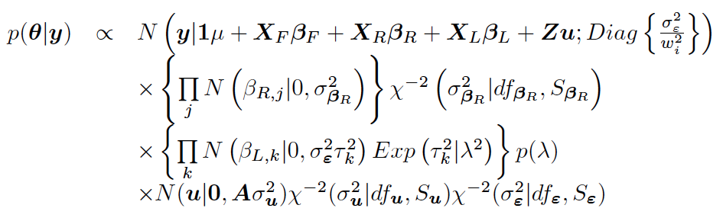
Bayesian likelihood

Slide 27
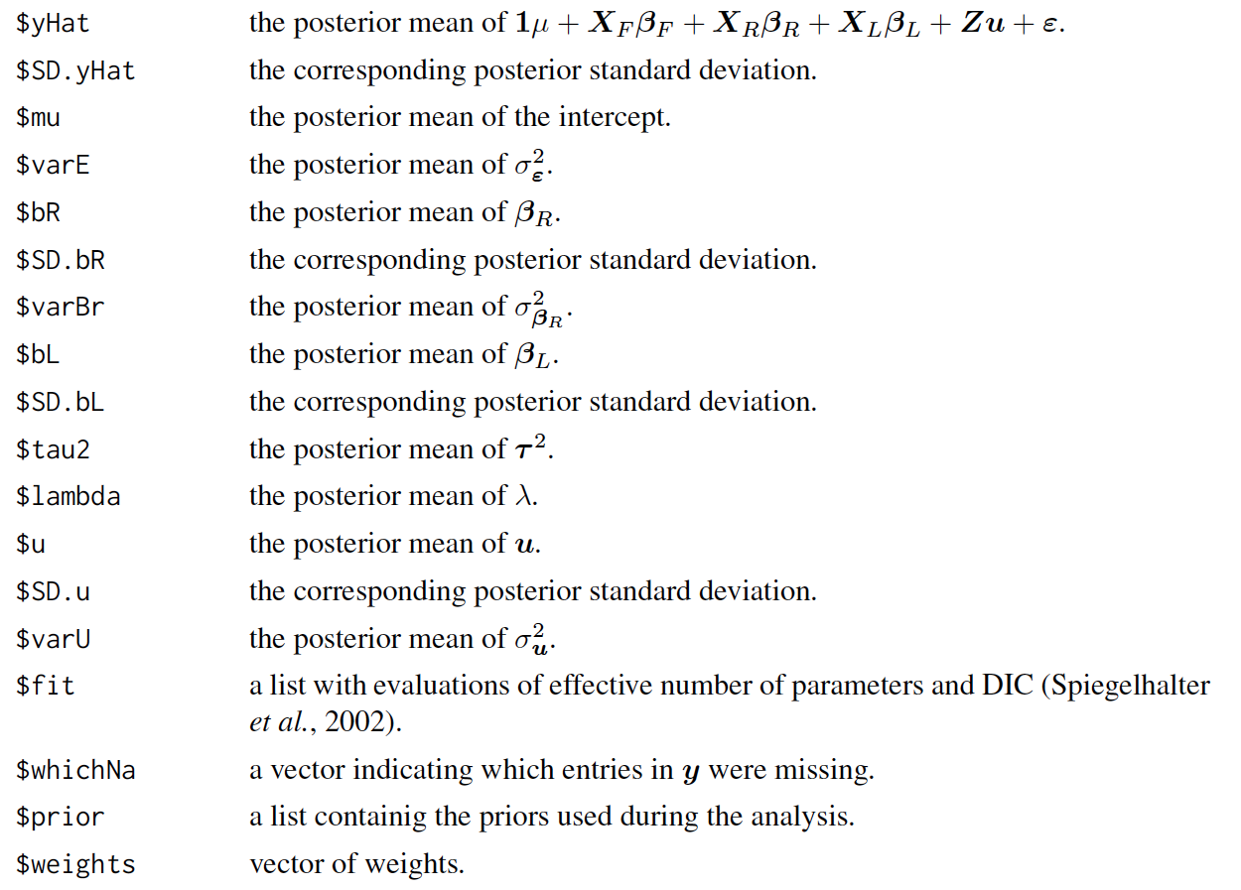
BLR output

Slide 28
Run BLR
#install.packages("BGLR")
library(BLR)
nIter=2000 #### number of iteration
burnIn=1500 #### burnin a part of iteration
myBLR =BLR(y=as.matrix(myY[train,2]),
XF=pcEnv[train,],
XL=as.matrix(myGD[train,-1]),
nIter=nIter,
burnIn=burnIn)
pred.inf=as.matrix(myGD[pred,-1])%*%myBLR$bL
pred.ref=as.matrix(myGD[train,-1])%*%myBLR$bL
accuracy <- cor(myY[pred,2],pred.inf)
modelfit <- cor(myY[train,2],pred.ref)
accuracy
modelfit
0.1364273
0.7958675

Slide 29
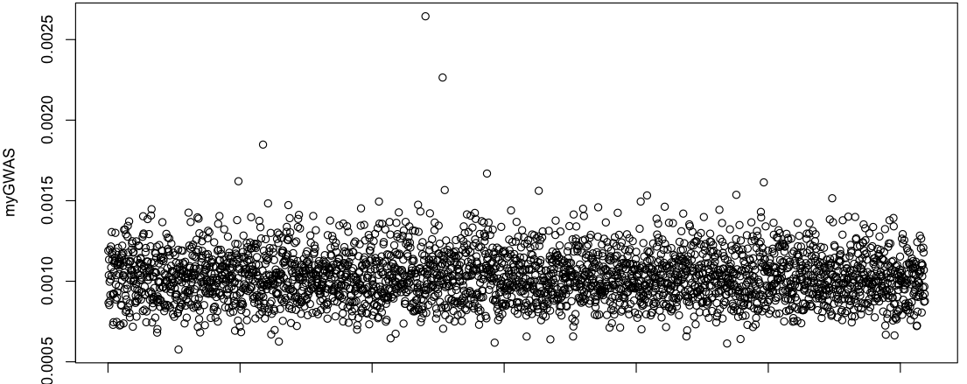
GWAS
myGWAS=myBLR$tau2
plot(myGWAS)
myP=1/(exp(myGWAS))
myGI.MP=cbind(myGM[,-1],myP)
GAPIT.Manhattan(GI.MP=myGI.MP,seqQTN=mySim$QTN.position)

Slide 30
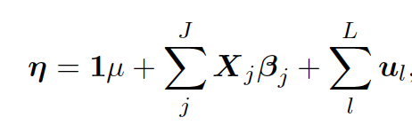
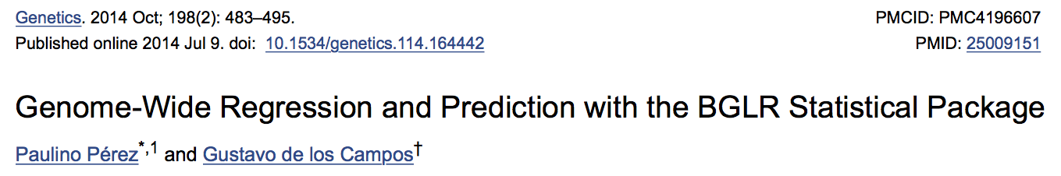
BGLR model
Markers
Individuals

Slide 31
Run BGLR
#install.packages("BGLR")
library(BGLR)
nIter=2000 #### number of iteration
burnIn=1500 #### burnin a part of iteration
myBGLR =BGLR(y=as.matrix(myY[train,2]),
ETA=list(list(X=pcEnv[train,],model='FIXED', saveEffects=TRUE),
list(X=as.matrix(myGD[train,-1]),model='BRR', saveEffects=TRUE)
#list(X=as.matrix(myGD[train,-1]),model='BL', saveEffects=TRUE)
#list(X=as.matrix(myGD[train,-1]),model='BayesA', saveEffects=TRUE)
#list(X=as.matrix(myGD[train,-1]),model='BayesB', saveEffects=TRUE)
),
nIter=nIter,
burnIn=burnIn)
pred.inf=as.matrix(myGD[pred,-1])%*%myBGLR$ETA[[2]]$b
pred.ref=as.matrix(myGD[train,-1])%*%myBGLR$ETA[[2]]$b
accuracy <- cor(myY[pred,2],pred.inf)
modelfit <- cor(myY[train,2],pred.ref)
accuracy
modelfit
0.1435651
0.8295513

Slide 32
GWAS
myGWAS=abs(myBGLR$ETA[[2]]$b)
plot(myGWAS)

Slide 33
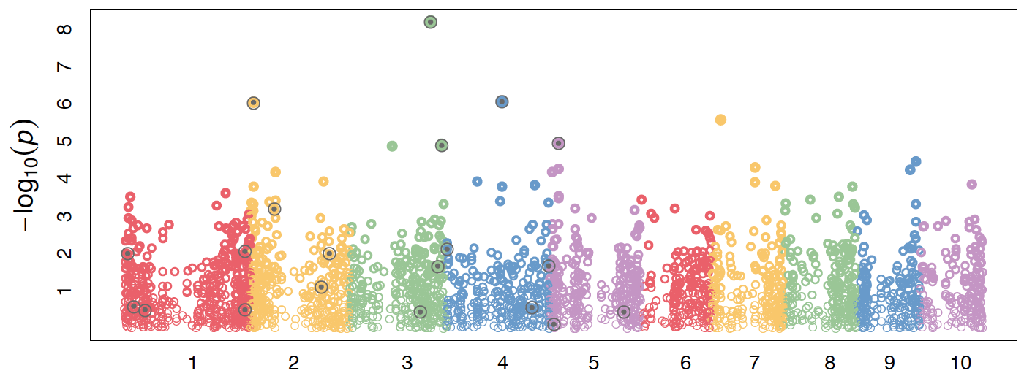
Visualization by GAPIT
myP=1/(exp(100*myGWAS))
myGI.MP=cbind(myGM[,-1],myP)
GAPIT.Manhattan(GI.MP=myGI.MP,seqQTN=mySim$QTN.position)
GAPIT.QQ(myP)

Slide 34
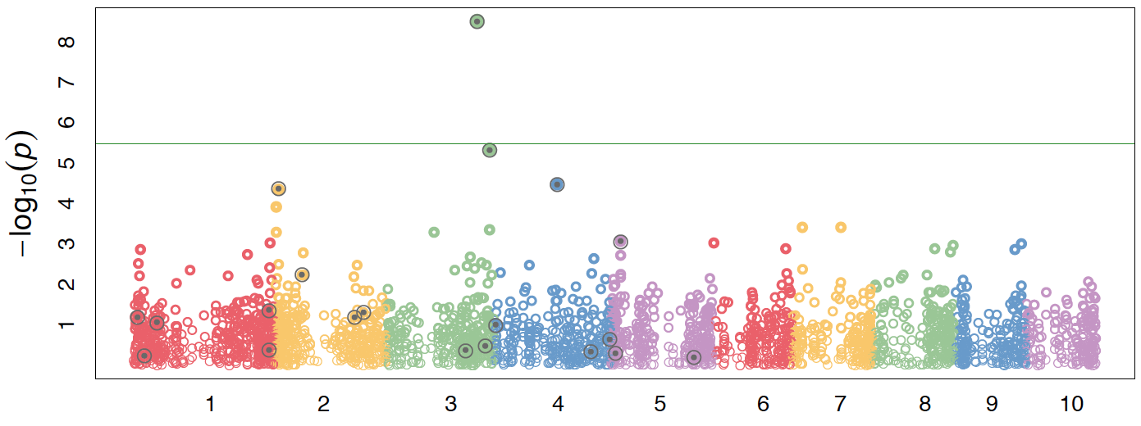
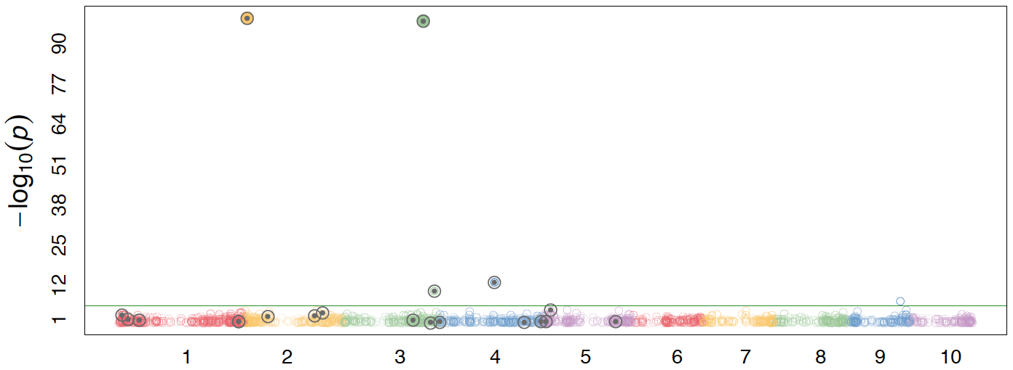
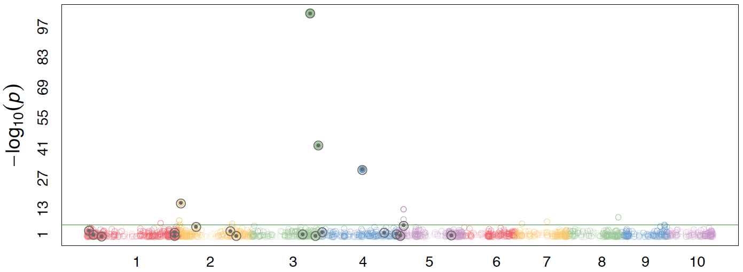
Comparison
Method | Testing | Training
RR | .14 | .83
BL | .16 | .81
BayesA | .24 | .72
BayesB | .38 | .79

Slide 35
Outline
BAGS
BLR
BGLR

